Slide 2

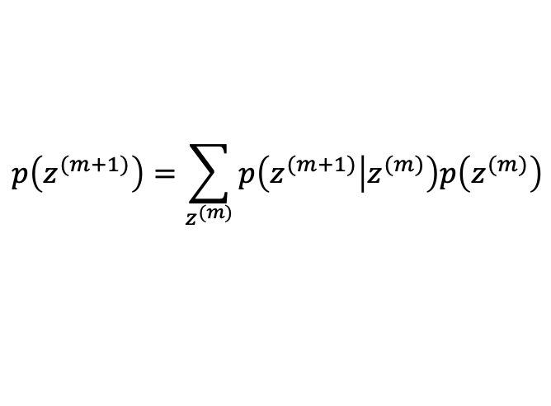

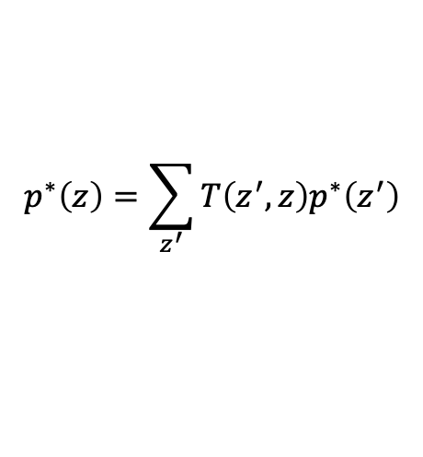
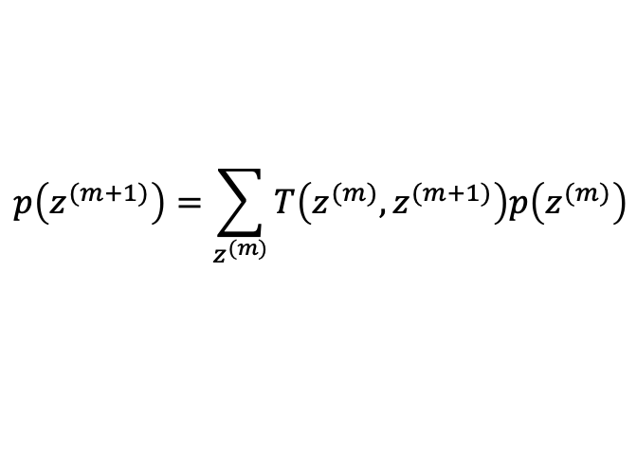
$$p\left(z^{(m+1)}\right)=\sum_{z^{(m)}}{p\left(z^{(m+1)} | z^{(m)}\right)p\left(z^{(m)}\right)}$$
$$p\left(z^{(m+1)}\right)=\sum_{z^{(m)}}{T\left(z^{(m)},z^{(m+1)}\right)p\left(z^{(m)}\right)}$$
$$p\left(z^{(m+1)} | z^{(m)}\right)≡T\left(z^{(m)},z^{(m+1)}\right)$$
$$p^{∗}\left(z\right)=\sum_{z^{′}}{T\left(z^{′},z\right)p^{∗}\left(z^{′}\right)}$$
Condition?
$$p^{∗}\left(z^{′}\right)T\left(z^{′},z\right)=p^{∗}\left(z\right)T\left({z,z}^{′}\right)$$
Page Rank Algorithm
Metropolis-Hastings Algorithm

Slide 3
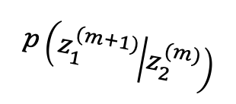
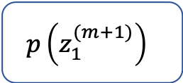
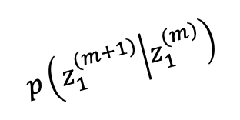
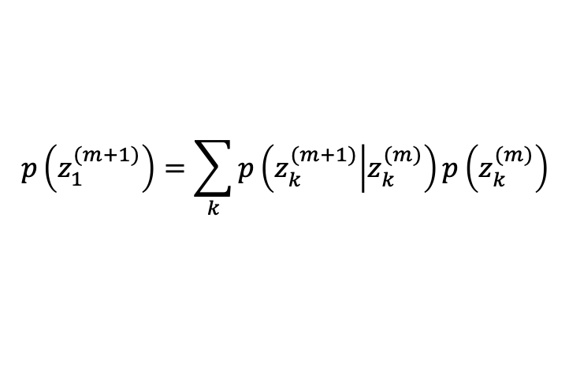
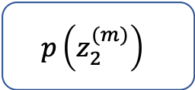

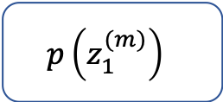
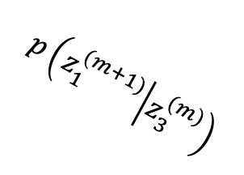
$$p\left(z_{1}^{(m)}\right)$$
$$p\left(z_{1}^{(m+1)} | z_{1}^{(m)}\right)$$
$$p\left(z_{1}^{(m+1)}\right)$$
$$p\left(z_{1}^{(m+1)} | z_{2}^{(m)}\right)$$
$$p\left(z_{2}^{(m)}\right)$$
$$p\left(z_{1}^{(m+1)} | z_{3}^{(m)}\right)$$
$$p\left(z_{3}^{(m)}\right)$$
$$p\left(z_{1}^{(m+1)}\right)=\sum_{k}{p\left(z_{k}^{(m+1)} | z_{k}^{(m)}\right)p\left(z_{k}^{(m)}\right)}$$

Slide 4
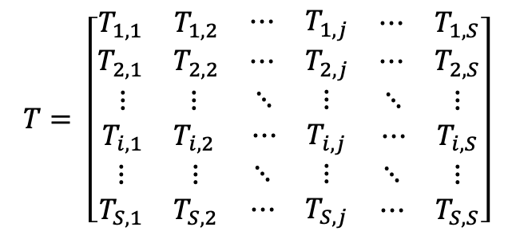

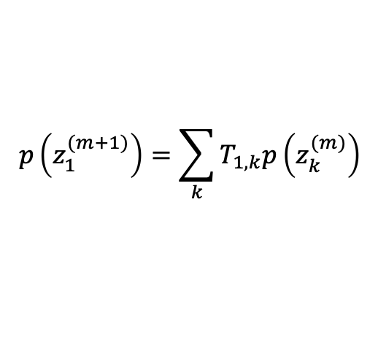

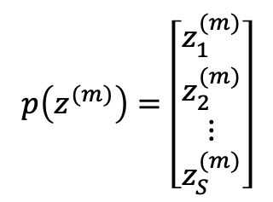
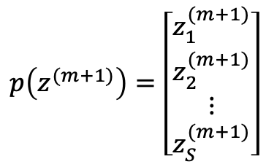
$$T= \left[\begin{matrix}\begin{matrix}T_{1,1} & T_{1,2} \\ T_{2,1} & T_{2,2}\end{matrix} & \begin{matrix}⋯ & T_{1,j} \\ ⋯ & T_{2,j}\end{matrix} & \begin{matrix}⋯ & T_{1,S} \\ ⋯ & T_{2,S}\end{matrix} \\ \begin{matrix}⋮ & ⋮ \\ T_{i,1} & T_{i,2}\end{matrix} & \begin{matrix}⋱ & ⋮ \\ ⋯ & T_{i,j}\end{matrix} & \begin{matrix}⋱ & ⋮ \\ ⋯ & T_{i,S}\end{matrix} \\ \begin{matrix}⋮ & ⋮ \\ T_{S,1} & T_{S,2}\end{matrix} & \begin{matrix}⋱ & ⋮ \\ ⋯ & T_{S,j}\end{matrix} & \begin{matrix}⋱ & ⋮ \\ ⋯ & T_{S,S}\end{matrix}\end{matrix}\right]$$
$$p\left(z^{(m+1)}\right)=\left[\begin{matrix}\begin{matrix}z_{1}^{(m+1)} \\ z_{2}^{(m+1)}\end{matrix} \\ \begin{matrix}⋮ \\ z_{S}^{(m+1)}\end{matrix}\end{matrix}\right]$$
$$p\left(z^{(m)}\right)=\left[\begin{matrix}\begin{matrix}z_{1}^{(m)} \\ z_{2}^{(m)}\end{matrix} \\ \begin{matrix}⋮ \\ z_{S}^{(m)}\end{matrix}\end{matrix}\right]$$
$$T_{i,j}≡p\left(z_{i}^{(m+1)} | z_{j}^{(m)}\right)$$
$$p\left(z_{1}^{(m+1)}\right)=\sum_{k}{T_{1,k}p\left(z_{k}^{(m)}\right)}$$
$$p\left(z^{(m+1)}\right)=Tp\left(z^{(m)}\right)$$

Slide 5
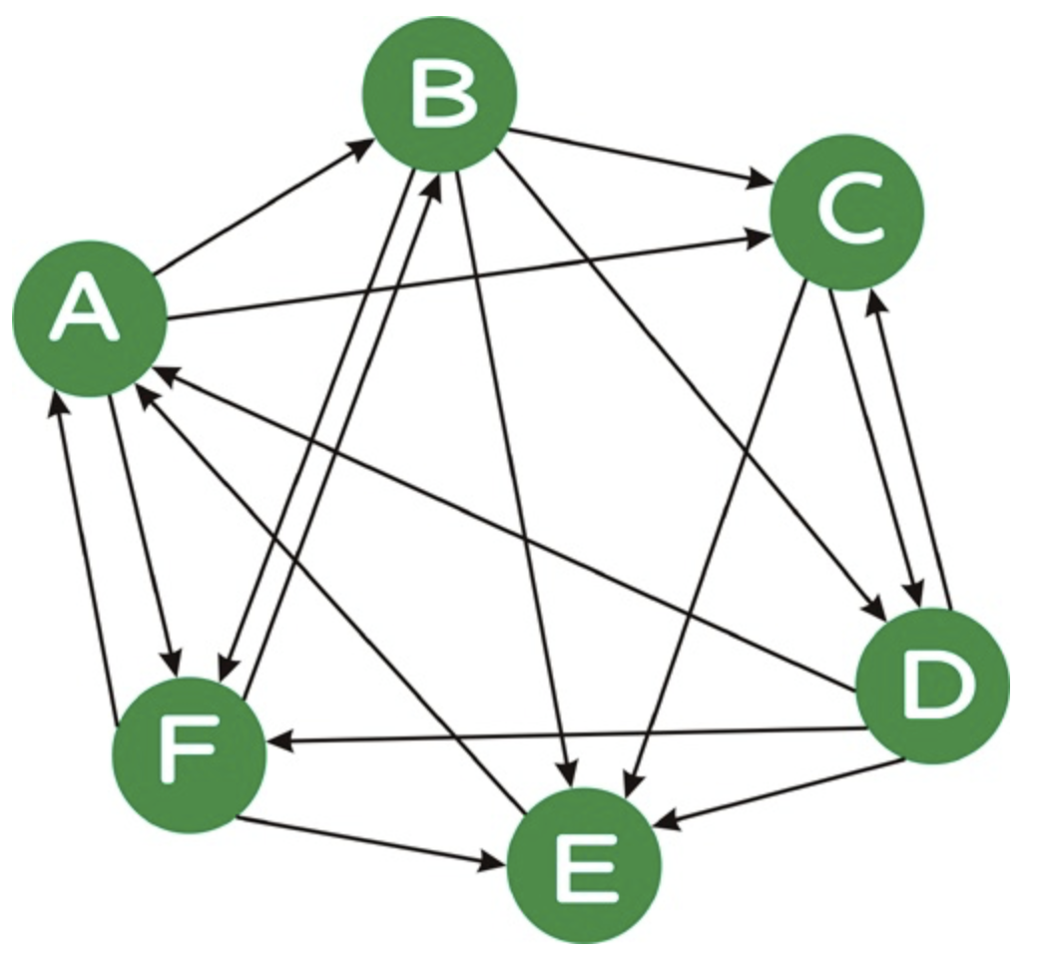
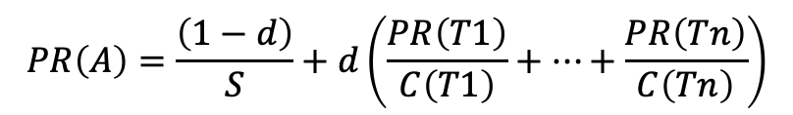
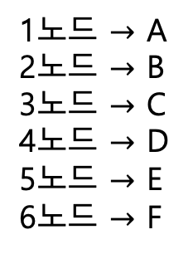
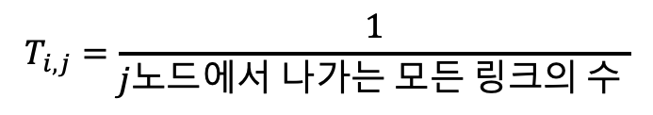

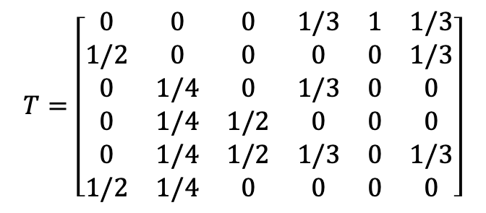
$$T=\left[\begin{matrix}0 & 0 & 0 & 1/3 & 1 & 1/3 \\ 1/2 & 0 & 0 & 0 & 0 & 1/3 \\ 0 & 1/4 & 0 & 1/3 & 0 & 0 \\ 0 & 1/4 & 1/2 & 0 & 0 & 0 \\ 0 & 1/4 & 1/2 & 1/3 & 0 & 1/3 \\ 1/2 & 1/4 & 0 & 0 & 0 & 0\end{matrix}\right]$$
1노드 $→$ A
2노드 $→$ B
3노드 $→$ C
4노드 $→$ D
5노드 $→$ E
6노드 $→$ F
$$T_{i,j}=\frac{1}{j노드에서 나가는 모든 링크의 수 }$$
$T_{i,j}$는 $j$노드에서 $i$노드로 전이될 확률
<Page Rank example>
$$PR\left(A\right)=\frac{\left(1−d\right)}{S}+d\left(\frac{PR\left(T1\right)}{C\left(T1\right)}+⋯+\frac{PR\left(Tn\right)}{C\left(Tn\right)}\right)$$
Notes:
그림 링크 : http://www.ccs.neu.edu/home/ekanou/ISU535.09X2/Homeworks/hw.03.html

Slide 6
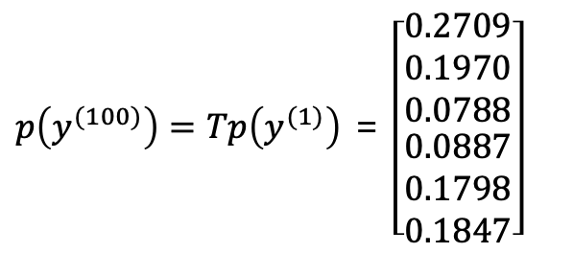
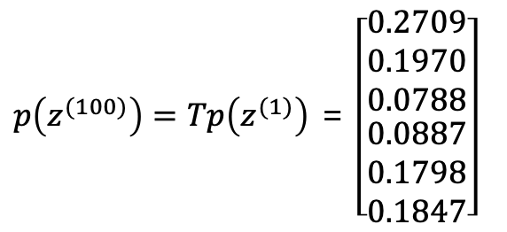
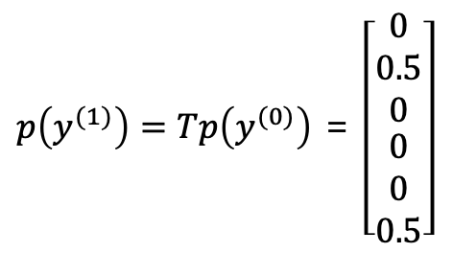
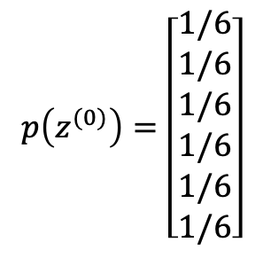
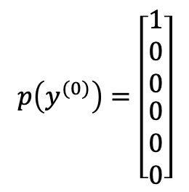
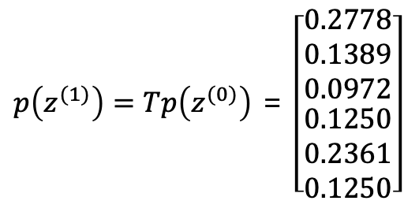
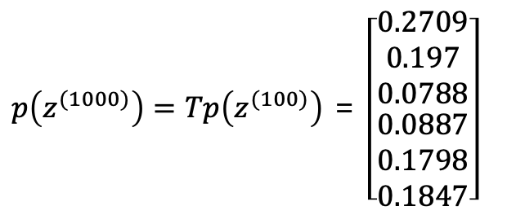
$$p\left(z^{(0)}\right)=\left[\begin{aligned}\begin{matrix}1/6 \\ 1/6 \\ 1/6\end{matrix} \\ 1/6 \\ 1/6 \\ 1/6\end{aligned}\right]$$
$p\left(z^{(1)}\right)=Tp\left(z^{(0)}\right)$ = $\left[\begin{aligned}\begin{matrix}0.2778 \\ 0.1389 \\ 0.0972\end{matrix} \\ 0.1250 \\ 0.2361 \\ 0.1250\end{aligned}\right]$
$p\left(z^{(100)}\right)=Tp\left(z^{(1)}\right)$ = $\left[\begin{aligned}\begin{matrix}0.2709 \\ 0.1970 \\ 0.0788\end{matrix} \\ 0.0887 \\ 0.1798 \\ 0.1847\end{aligned}\right]$
$p\left(z^{(1000)}\right)=Tp\left(z^{(100)}\right)$ = $\left[\begin{aligned}\begin{matrix}0.2709 \\ 0.197 \\ 0.0788\end{matrix} \\ 0.0887 \\ 0.1798 \\ 0.1847\end{aligned}\right]$
$$p\left(y^{(0)}\right)=\left[\begin{aligned}\begin{matrix}1 \\ 0 \\ 0\end{matrix} \\ 0 \\ 0 \\ 0\end{aligned}\right]$$
$p\left(y^{(1)}\right)=Tp\left(y^{(0)}\right)$ = $\left[\begin{aligned}\begin{matrix}0 \\ 0.5 \\ 0\end{matrix} \\ 0 \\ 0 \\ 0.5\end{aligned}\right]$
$p\left(y^{(100)}\right)=Tp\left(y^{(1)}\right)$ = $\left[\begin{aligned}\begin{matrix}0.2709 \\ 0.1970 \\ 0.0788\end{matrix} \\ 0.0887 \\ 0.1798 \\ 0.1847\end{aligned}\right]$

Slide 7
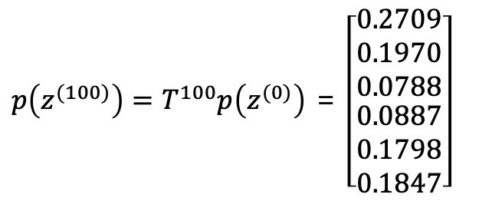
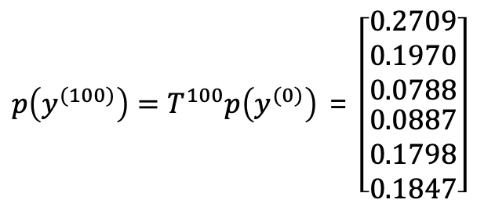
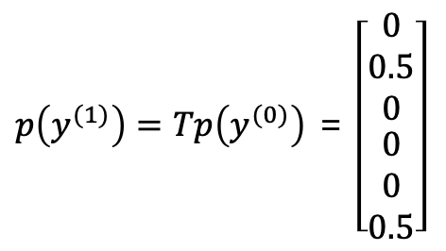
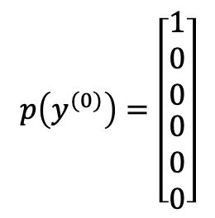
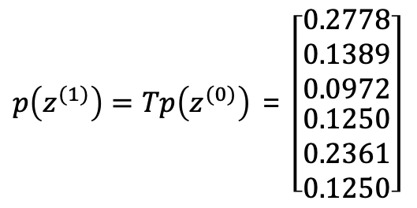
$$p\left(z^{(0)}\right)=\left[\begin{aligned}\begin{matrix}1/6 \\ 1/6 \\ 1/6\end{matrix} \\ 1/6 \\ 1/6 \\ 1/6\end{aligned}\right]$$
$p\left(z^{(1)}\right)=Tp\left(z^{(0)}\right)$ = $\left[\begin{aligned}\begin{matrix}0.2778 \\ 0.1389 \\ 0.0972\end{matrix} \\ 0.1250 \\ 0.2361 \\ 0.1250\end{aligned}\right]$
$p\left(z^{(100)}\right)=T^{100}p\left(z^{(0)}\right)$ = $\left[\begin{aligned}\begin{matrix}0.2709 \\ 0.1970 \\ 0.0788\end{matrix} \\ 0.0887 \\ 0.1798 \\ 0.1847\end{aligned}\right]$
$$p\left(y^{(0)}\right)=\left[\begin{aligned}\begin{matrix}1 \\ 0 \\ 0\end{matrix} \\ 0 \\ 0 \\ 0\end{aligned}\right]$$
$p\left(y^{(1)}\right)=Tp\left(y^{(0)}\right)$ = $\left[\begin{aligned}\begin{matrix}0 \\ 0.5 \\ 0\end{matrix} \\ 0 \\ 0 \\ 0.5\end{aligned}\right]$
$p\left(y^{(100)}\right)=T^{100}p\left(y^{(0)}\right)$ = $\left[\begin{aligned}\begin{matrix}0.2709 \\ 0.1970 \\ 0.0788\end{matrix} \\ 0.0887 \\ 0.1798 \\ 0.1847\end{aligned}\right]$

Slide 8

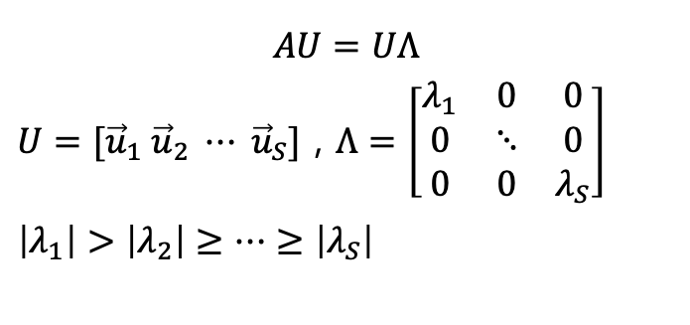
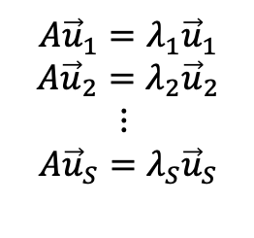
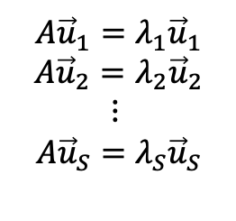
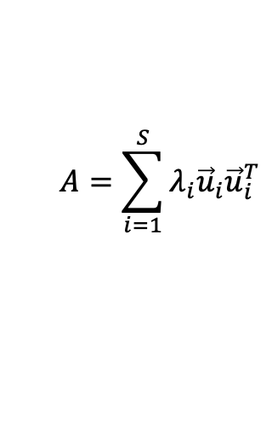
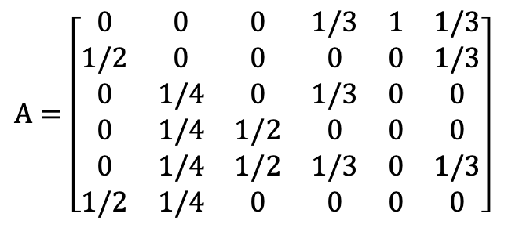
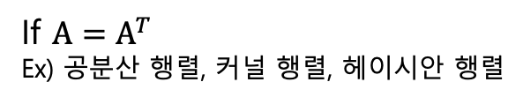

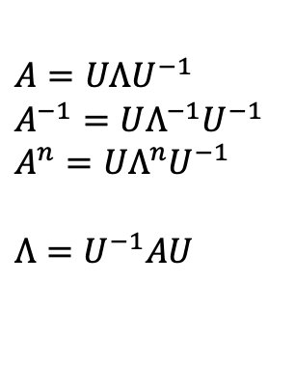
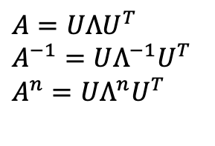
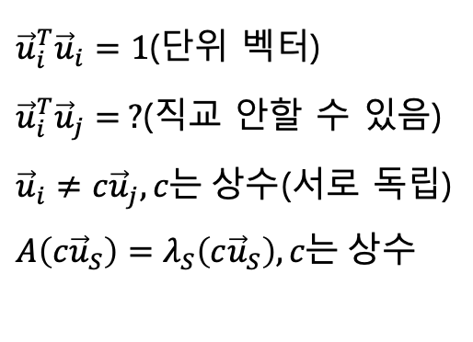
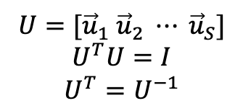
$A=\left[\begin{matrix}0 & 0 & 0 & 1/3 & 1 & 1/3 \\ 1/2 & 0 & 0 & 0 & 0 & 1/3 \\ 0 & 1/4 & 0 & 1/3 & 0 & 0 \\ 0 & 1/4 & 1/2 & 0 & 0 & 0 \\ 0 & 1/4 & 1/2 & 1/3 & 0 & 1/3 \\ 1/2 & 1/4 & 0 & 0 & 0 & 0\end{matrix}\right]$
If $A=A^{T}$
Ex) 공분산 행렬, 커널 행렬, 헤이시안 행렬
${\vec{u}}_{i}^{T}{\vec{u}}_{i}=1$(단위 벡터)
${\vec{u}}_{i}^{T}{\vec{u}}_{j}=0$(직교)
${\vec{u}}_{i}≠{c\vec{u}}_{j},c는 상수$(서로 독립)
$$A{\vec{u}}_{1}=λ_{1}{\vec{u}}_{1}$$
$$A{\vec{u}}_{2}=λ_{2}{\vec{u}}_{2}$$
$$⋮$$
$$A{\vec{u}}_{S}=λ_{S}{\vec{u}}_{S}$$
${\vec{u}}_{i}^{T}{\vec{u}}_{i}=1$(단위 벡터)
${\vec{u}}_{i}^{T}{\vec{u}}_{j}= ?$(직교 안할 수 있음)
${\vec{u}}_{i}≠{c\vec{u}}_{j},c는 상수$(서로 독립)
$A\left(c{\vec{u}}_{S}\right)=λ_{S}\left(c{\vec{u}}_{S}\right),c는 상수$
$$A{\vec{u}}_{1}=λ_{1}{\vec{u}}_{1}$$
$$A{\vec{u}}_{2}=λ_{2}{\vec{u}}_{2}$$
$$⋮$$
$$A{\vec{u}}_{S}=λ_{S}{\vec{u}}_{S}$$
$$U=[{\vec{u}}_{1} {\vec{u}}_{2} ⋯ {\vec{u}}_{S}]$$
$$U^{T}U=I$$
$$U^{T}=U^{−1}$$
$A=UΛU^{−1}$
$A^{−1}=UΛ^{−1}U^{−1}$
$A^{n}=UΛ^{n}U^{−1}$
$Λ=U^{−1}AU$
$A=UΛU^{T}$
$A^{−1}=UΛ^{−1}U^{T}$
$A^{n}=UΛ^{n}U^{T}$
$$AU=UΛ$$
$U=[{\vec{u}}_{1} {\vec{u}}_{2} ⋯ {\vec{u}}_{S}]$ , $Λ=\left[\begin{matrix}λ_{1} & 0 & 0 \\ 0 & ⋱ & 0 \\ 0 & 0 & λ_{S}\end{matrix}\right]$
$\left|λ_{1}\right|>\left|λ_{2}\right|≥⋯≥\left|λ_{S}\right|$
$$Λ=U^{T}AU$$
$$A=\sum_{i=1}^{S}{λ_{i}{\vec{u}}_{i}{\vec{u}}_{i}^{T}}$$

Slide 9
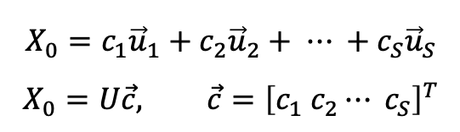
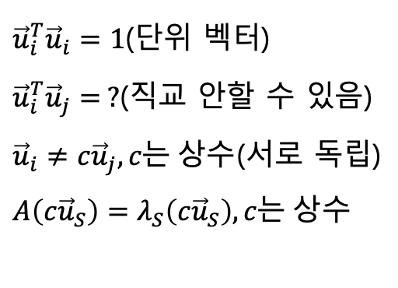

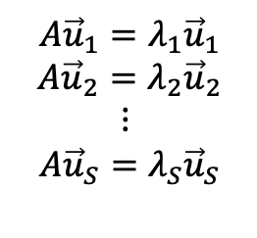

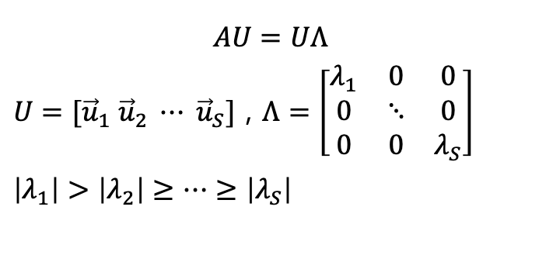
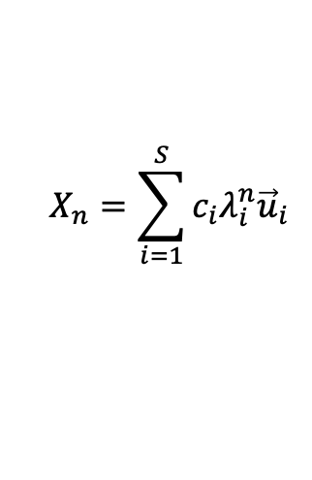
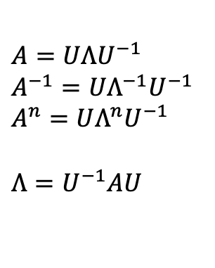
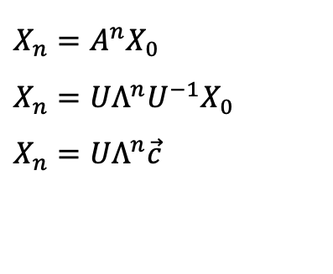
$A=UΛU^{−1}$
$A^{−1}=UΛ^{−1}U^{−1}$
$A^{n}=UΛ^{n}U^{−1}$
$Λ=U^{−1}AU$
$A$는 $S\text{×}S$ matrix
${\vec{u}}_{i}^{T}{\vec{u}}_{i}=1$(단위 벡터)
${\vec{u}}_{i}^{T}{\vec{u}}_{j}= ?$(직교 안할 수 있음)
${\vec{u}}_{i}≠{c\vec{u}}_{j},c는 상수$(서로 독립)
$A\left(c{\vec{u}}_{S}\right)=λ_{S}\left(c{\vec{u}}_{S}\right),c는 상수$
$$AU=UΛ$$
$U=[{\vec{u}}_{1} {\vec{u}}_{2} ⋯ {\vec{u}}_{S}]$ , $Λ=\left[\begin{matrix}λ_{1} & 0 & 0 \\ 0 & ⋱ & 0 \\ 0 & 0 & λ_{S}\end{matrix}\right]$
$\left|λ_{1}\right|>\left|λ_{2}\right|≥⋯≥\left|λ_{S}\right|$
$$A{\vec{u}}_{1}=λ_{1}{\vec{u}}_{1}$$
$$A{\vec{u}}_{2}=λ_{2}{\vec{u}}_{2}$$
$$⋮$$
$$A{\vec{u}}_{S}=λ_{S}{\vec{u}}_{S}$$
$$X_{n+1}={AX}_{n}, X_{0}=p(z_{0})$$
$X_{n}=A^{n}X_{0}$
$X_{n}=UΛ^{n}U^{−1}X_{0}$
$X_{n}=UΛ^{n}\vec{c}$
$$X_{0}={c_{1}\vec{u}}_{1}+c_{2}{\vec{u}}_{2}+ ⋯ +c_{S}{\vec{u}}_{S}$$
$$X_{0}=U\vec{c}, \vec{c}={\left[c_{1} c_{2}⋯ c_{S}\right]}^{T}$$
$$X_{n}=\sum_{i=1}^{S}{{c_{i}λ_{i}^{n}\vec{u}}_{i}}$$

Slide 10
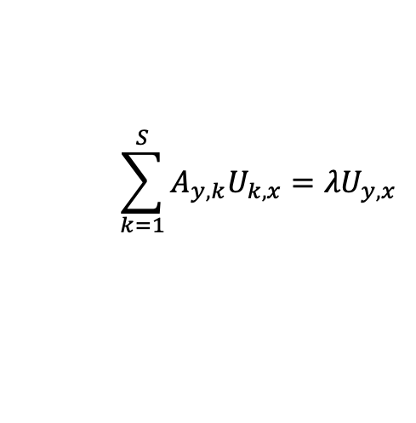
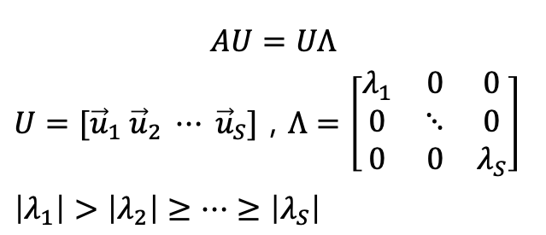





$$\sum_{k=1}^{S}{A_{k,j}}=1$$
$$A_{i,j}≥0$$
$$X_{n+1}={AX}_{n}, X_{0}=p(z_{0})$$
$$X_{0}={c_{1}\vec{u}}_{1}+c_{2}{\vec{u}}_{2}+ ⋯ +c_{S}{\vec{u}}_{S}$$
$$X_{0}=U\vec{c}, \vec{c}={\left[c_{1} c_{2}⋯ c_{S}\right]}^{T}$$
$$AU=UΛ$$
$U=[{\vec{u}}_{1} {\vec{u}}_{2} ⋯ {\vec{u}}_{S}]$ , $Λ=\left[\begin{matrix}λ_{1} & 0 & 0 \\ 0 & ⋱ & 0 \\ 0 & 0 & λ_{S}\end{matrix}\right]$
$\left|λ_{1}\right|>\left|λ_{2}\right|≥⋯≥\left|λ_{S}\right|$
$X_{n}=A^{n}X_{0}$
$X_{n}=UΛ^{n}U^{−1}X_{0}$
$X_{n}=UΛ^{n}\vec{c}$
$X_{n}=\sum_{i=1}^{S}{{c_{i}λ_{i}^{n}\vec{u}}_{i}}$
$X_{∞}={c_{1}\vec{u}}_{1}$
$AX_{∞}=X_{∞}$
$A\left({c_{1}\vec{u}}_{1}\right)={c_{1}\vec{u}}_{1}$
$$\sum_{k=1}^{S}{A_{y,k}U_{k,x}}={λU}_{y,x}$$

Slide 11




$$\left[\begin{matrix}\begin{matrix}A_{1,1} & A_{1,2} \\ A_{2,1} & A_{2,2}\end{matrix} & \begin{matrix}⋯ & A_{1,j} \\ ⋯ & A_{2,j}\end{matrix} & \begin{matrix}⋯ & A_{1,S} \\ ⋯ & A_{2,S}\end{matrix} \\ \begin{matrix}⋮ & ⋮ \\ A_{i,1} & A_{i,2}\end{matrix} & \begin{matrix}⋱ & ⋮ \\ ⋯ & A_{i,j}\end{matrix} & \begin{matrix}⋱ & ⋮ \\ ⋯ & A_{i,S}\end{matrix} \\ \begin{matrix}⋮ & ⋮ \\ A_{S,1} & A_{S,2}\end{matrix} & \begin{matrix}⋱ & ⋮ \\ ⋯ & A_{S,j}\end{matrix} & \begin{matrix}⋱ & ⋮ \\ ⋯ & A_{S,S}\end{matrix}\end{matrix}\right]\left[\begin{matrix}\begin{matrix}U_{1,1} & U_{1,2} \\ U_{2,1} & U_{2,2}\end{matrix} & \begin{matrix}⋯ & U_{1,j} \\ ⋯ & U_{2,j}\end{matrix} & \begin{matrix}⋯ & U_{1,S} \\ ⋯ & U_{2,S}\end{matrix} \\ \begin{matrix}⋮ & ⋮ \\ U_{i,1} & U_{i,2}\end{matrix} & \begin{matrix}⋱ & ⋮ \\ ⋯ & U_{i,j}\end{matrix} & \begin{matrix}⋱ & ⋮ \\ ⋯ & U_{i,S}\end{matrix} \\ \begin{matrix}⋮ & ⋮ \\ U_{S,1} & U_{S,2}\end{matrix} & \begin{matrix}⋱ & ⋮ \\ ⋯ & U_{S,j}\end{matrix} & \begin{matrix}⋱ & ⋮ \\ ⋯ & U_{S,S}\end{matrix}\end{matrix}\right]$$
$$=\left[\begin{matrix}\begin{matrix}{λ_{1}U}_{1,1} & {λ_{2}U}_{1,2} \\ λ_{1}U_{2,1} & {λ_{2}U}_{2,2}\end{matrix} & \begin{matrix}⋯ & {λ_{j}U}_{1,j} \\ ⋯ & {λ_{j}U}_{2,j}\end{matrix} & \begin{matrix}⋯ & {λ_{S}U}_{1,S} \\ ⋯ & {λ_{S}U}_{2,S}\end{matrix} \\ \begin{matrix}⋮ & ⋮ \\ λ_{1}U_{i,1} & {λ_{2}U}_{i,2}\end{matrix} & \begin{matrix}⋱ & ⋮ \\ ⋯ & {λ_{j}U}_{i,j}\end{matrix} & \begin{matrix}⋱ & ⋮ \\ ⋯ & {λ_{S}U}_{i,S}\end{matrix} \\ \begin{matrix}⋮ & ⋮ \\ {λ_{1}U}_{S,1} & {λ_{2}U}_{S,2}\end{matrix} & \begin{matrix}⋱ & ⋮ \\ ⋯ & {λ_{j}U}_{S,j}\end{matrix} & \begin{matrix}⋱ & ⋮ \\ ⋯ & {λ_{S}U}_{S,S}\end{matrix}\end{matrix}\right]$$
$\sum_{k=1}^{S}{A_{k,j}}=1$
$A_{i,j}≥0$
$$AU=UΛ$$
$U=[{\vec{u}}_{1} {\vec{u}}_{2} ⋯ {\vec{u}}_{S}]$ , $Λ=\left[\begin{matrix}λ_{1} & 0 & 0 \\ 0 & ⋱ & 0 \\ 0 & 0 & λ_{S}\end{matrix}\right]$
$\left|λ_{1}\right|>\left|λ_{2}\right|≥⋯≥\left|λ_{S}\right|$
$$\sum_{k=1}^{S}{A_{y,k}U_{k,x}}={λ_{x}U}_{y,x}$$
$\left|{λ_{x}U}_{y,x}\right|=\left|λ_{x}\right|\left|U_{y,x}\right|$= $\left|\sum_{k=1}^{S}{A_{y,k}U_{k,x}}\right|≤\sum_{k=1}^{S}{A_{y,k}\left|U_{k,x}\right|≤\sum_{k=1}^{S}{A_{y,k}\left|U_{y,x}\right|}}$

Slide 12

$$\left[\begin{matrix}\begin{matrix}A_{1,1} & A_{1,2} \\ A_{2,1} & A_{2,2}\end{matrix} & \begin{matrix}⋯ & A_{1,j} \\ ⋯ & A_{2,j}\end{matrix} & \begin{matrix}⋯ & A_{1,S} \\ ⋯ & A_{2,S}\end{matrix} \\ \begin{matrix}⋮ & ⋮ \\ A_{i,1} & A_{i,2}\end{matrix} & \begin{matrix}⋱ & ⋮ \\ ⋯ & A_{i,j}\end{matrix} & \begin{matrix}⋱ & ⋮ \\ ⋯ & A_{i,S}\end{matrix} \\ \begin{matrix}⋮ & ⋮ \\ A_{S,1} & A_{S,2}\end{matrix} & \begin{matrix}⋱ & ⋮ \\ ⋯ & A_{S,j}\end{matrix} & \begin{matrix}⋱ & ⋮ \\ ⋯ & A_{S,S}\end{matrix}\end{matrix}\right]\left[\begin{matrix}\begin{matrix}U_{1,1} & U_{1,2} \\ U_{2,1} & U_{2,2}\end{matrix} & \begin{matrix}⋯ & U_{1,j} \\ ⋯ & U_{2,j}\end{matrix} & \begin{matrix}⋯ & U_{1,S} \\ ⋯ & U_{2,S}\end{matrix} \\ \begin{matrix}⋮ & ⋮ \\ U_{i,1} & U_{i,2}\end{matrix} & \begin{matrix}⋱ & ⋮ \\ ⋯ & U_{i,j}\end{matrix} & \begin{matrix}⋱ & ⋮ \\ ⋯ & U_{i,S}\end{matrix} \\ \begin{matrix}⋮ & ⋮ \\ U_{S,1} & U_{S,2}\end{matrix} & \begin{matrix}⋱ & ⋮ \\ ⋯ & U_{S,j}\end{matrix} & \begin{matrix}⋱ & ⋮ \\ ⋯ & U_{S,S}\end{matrix}\end{matrix}\right]=\left[\begin{matrix}\begin{matrix}{λ_{1}U}_{1,1} & {λ_{2}U}_{1,2} \\ λ_{1}U_{2,1} & {λ_{2}U}_{2,2}\end{matrix} & \begin{matrix}⋯ & {λ_{j}U}_{1,j} \\ ⋯ & {λ_{j}U}_{2,j}\end{matrix} & \begin{matrix}⋯ & {λ_{S}U}_{1,S} \\ ⋯ & {λ_{S}U}_{2,S}\end{matrix} \\ \begin{matrix}⋮ & ⋮ \\ λ_{1}U_{i,1} & {λ_{2}U}_{i,2}\end{matrix} & \begin{matrix}⋱ & ⋮ \\ ⋯ & {λ_{j}U}_{i,j}\end{matrix} & \begin{matrix}⋱ & 怀 \\ ⋯ & {λ_{S}U}_{i,S}\end{matrix} \\ \begin{matrix}⋮ & ⋮ \\ {λ_{1}U}_{S,1} & {λ_{2}U}_{S,2}\end{matrix} & \begin{matrix}⋱ & ⋮ \\ ⋯ & {λ_{j}U}_{S,j}\end{matrix} & \begin{matrix}⋱ & ⋮ \\ ⋯ & {λ_{S}U}_{S,S}\end{matrix}\end{matrix}\right]$$
$$AU=UΛ$$
$$\sum_{k=1}^{S}{A_{y,k}U_{k,x}}={λ_{x}U}_{y,x}$$
$$\sum_{l=1}^{S}{\left(\sum_{k=1}^{S}{A_{l,k}U_{k,x}}\right)} =\sum_{l=1}^{S}{{λ_{x}U}_{l,x}}$$

Slide 13









$$AU=UΛ$$
$U=[{\vec{u}}_{1} {\vec{u}}_{2} ⋯ {\vec{u}}_{S}]$ , $Λ=\left[\begin{matrix}λ_{1} & 0 & 0 \\ 0 & ⋱ & 0 \\ 0 & 0 & λ_{S}\end{matrix}\right]$
$\left|λ_{1}\right|>\left|λ_{2}\right|≥⋯≥\left|λ_{S}\right|$
$$AU= \left[\begin{matrix}\begin{matrix}A_{1,1} & A_{1,2} \\ A_{2,1} & A_{2,2}\end{matrix} & \begin{matrix}⋯ & A_{1,j} \\ ⋯ & A_{2,j}\end{matrix} & \begin{matrix}⋯ & A_{1,S} \\ ⋯ & A_{2,S}\end{matrix} \\ \begin{matrix}⋮ & ⋮ \\ A_{i,1} & A_{i,2}\end{matrix} & \begin{matrix}⋱ & ⋮ \\ ⋯ & A_{i,j}\end{matrix} & \begin{matrix}⋱ & ⋮ \\ ⋯ & A_{i,S}\end{matrix} \\ \begin{matrix}⋮ & ⋮ \\ A_{S,1} & A_{S,2}\end{matrix} & \begin{matrix}⋱ & ⋮ \\ ⋯ & A_{S,j}\end{matrix} & \begin{matrix}⋱ & ⋮ \\ ⋯ & A_{S,S}\end{matrix}\end{matrix}\right]\left[\begin{matrix}\begin{matrix}U_{1,1} & U_{1,2} \\ U_{2,1} & U_{2,2}\end{matrix} & \begin{matrix}⋯ & U_{1,j} \\ ⋯ & U_{2,j}\end{matrix} & \begin{matrix}⋯ & U_{1,S} \\ ⋯ & U_{2,S}\end{matrix} \\ \begin{matrix}⋮ & ⋮ \\ U_{i,1} & U_{i,2}\end{matrix} & \begin{matrix}⋱ & ⋮ \\ ⋯ & U_{i,j}\end{matrix} & \begin{matrix}⋱ & ⋮ \\ ⋯ & U_{i,S}\end{matrix} \\ \begin{matrix}⋮ & ⋮ \\ U_{S,1} & U_{S,2}\end{matrix} & \begin{matrix}⋱ & ⋮ \\ ⋯ & U_{S,j}\end{matrix} & \begin{matrix}⋱ & ⋮ \\ ⋯ & U_{S,S}\end{matrix}\end{matrix}\right]$$
$$=\left[\begin{matrix}\begin{matrix}{λ_{1}U}_{1,1} & {λ_{2}U}_{1,2} \\ λ_{1}U_{2,1} & {λ_{2}U}_{2,2}\end{matrix} & \begin{matrix}⋯ & {λ_{j}U}_{1,j} \\ ⋯ & {λ_{j}U}_{2,j}\end{matrix} & \begin{matrix}⋯ & {λ_{S}U}_{1,S} \\ ⋯ & {λ_{S}U}_{2,S}\end{matrix} \\ \begin{matrix}⋮ & ⋮ \\ λ_{1}U_{i,1} & {λ_{2}U}_{i,2}\end{matrix} & \begin{matrix}⋱ & ⋮ \\ ⋯ & {λ_{j}U}_{i,j}\end{matrix} & \begin{matrix}⋱ & ⋮ \\ ⋯ & {λ_{S}U}_{i,S}\end{matrix} \\ \begin{matrix}⋮ & ⋮ \\ {λ_{1}U}_{S,1} & {λ_{2}U}_{S,2}\end{matrix} & \begin{matrix}⋱ & ⋮ \\ ⋯ & {λ_{j}U}_{S,j}\end{matrix} & \begin{matrix}⋱ & ⋮ \\ ⋯ & {λ_{S}U}_{S,S}\end{matrix}\end{matrix}\right]$$
$$\sum_{k=1}^{S}{A_{l,k}U_{k,x}}={λ_{x}U}_{l,x}$$
$\sum_{l=1}^{S}{A_{l,j}}=1$
$A_{i,j}≥0$
$$\sum_{l=1}^{S}{\left(\sum_{k=1}^{S}{A_{l,k}U_{k,x}}\right)} =\sum_{l=1}^{S}{{λ_{x}U}_{l,x}}$$
$$\sum_{l=1}^{S}{\left|{λ_{x}U}_{l,x}\right|}=\sum_{l=1}^{S}{\left|λ_{x}\right|\left|U_{l,x}\right|}\text{=}\sum_{l=1}^{S}{\left|\sum_{k=1}^{S}{A_{l,k}U_{k,x}}\right|}≤\sum_{l=1}^{S}{\sum_{k=1}^{S}{A_{l,k}\left|U_{k,x}\right|}}=\sum_{k=1}^{S}{\left|U_{k,x}\right|\sum_{l=1}^{S}{A_{l,k}}}$$
$$\left|λ_{x}\right|≤1$$
$$\sum_{l=1}^{S}{\left|λ_{x}\right|\left|U_{l,x}\right|≤\sum_{k=1}^{S}{\left|U_{k,x}\right|}}$$
$$\left|λ_{x}\right|\sum_{l=1}^{S}{\left|U_{l,x}\right|≤\sum_{k=1}^{S}{\left|U_{k,x}\right|}}$$

Slide 14







$$\sum_{k=1}^{S}{A_{l,k}U_{k,x}}={λ_{x}U}_{l,x}$$
$\sum_{l=1}^{S}{A_{l,j}}=1$
$A_{i,j}≥0$
$$\sum_{l=1}^{S}{\left(\sum_{k=1}^{S}{A_{l,k}U_{k,x}}\right)} =\sum_{l=1}^{S}{{λ_{x}U}_{l,x}}$$
$$\sum_{l=1}^{S}{\left|{λ_{x}U}_{l,x}\right|}=\sum_{l=1}^{S}{\left|λ_{x}\right|\left|U_{l,x}\right|}\text{=}\sum_{l=1}^{S}{\left|\sum_{k=1}^{S}{A_{l,k}U_{k,x}}\right|}≤\sum_{l=1}^{S}{\sum_{k=1}^{S}{A_{l,k}\left|U_{k,x}\right|}}=\sum_{k=1}^{S}{\left|U_{k,x}\right|\sum_{l=1}^{S}{A_{l,k}}}$$
$$\sum_{l=1}^{S}{\left|λ_{x}\right|\left|U_{l,x}\right|≤\sum_{k=1}^{S}{\left|U_{k,x}\right|}}$$
$$\left|λ_{x}\right|\sum_{l=1}^{S}{\left|U_{l,x}\right|≤\sum_{k=1}^{S}{\left|U_{k,x}\right|}}$$
$$\left|λ_{x}\right|\left(\left|U_{1,x}\right|+\left|U_{2,x}\right|+ ⋯ +\left|U_{S,x}\right|\right)≤\left|U_{1,x}\right|+\left|U_{2,x}\right|+ ⋯ +\left|U_{S,x}\right|$$
$$\left|λ_{x}\right|≤1$$

Slide 15





$$A=\left[\begin{matrix}\begin{matrix}A_{1,1} & A_{1,2} \\ A_{2,1} & A_{2,2}\end{matrix} & \begin{matrix}⋯ & A_{1,j} \\ ⋯ & A_{2,j}\end{matrix} & \begin{matrix}⋯ & A_{1,S} \\ ⋯ & A_{2,S}\end{matrix} \\ \begin{matrix}⋮ & ⋮ \\ A_{i,1} & A_{i,2}\end{matrix} & \begin{matrix}⋱ & ⋮ \\ ⋯ & A_{i,j}\end{matrix} & \begin{matrix}⋱ & ⋮ \\ ⋯ & A_{i,S}\end{matrix} \\ \begin{matrix}⋮ & ⋮ \\ A_{S,1} & A_{S,2}\end{matrix} & \begin{matrix}⋱ & ⋮ \\ ⋯ & A_{S,j}\end{matrix} & \begin{matrix}⋱ & ⋮ \\ ⋯ & A_{S,S}\end{matrix}\end{matrix}\right]$$
$\sum_{i=1}^{S}{A_{i,j}}=1$
$A_{i,j}≥0$
$${\left(A−I\right)}^{T}\vec{1}=0$$
$${\vec{A}}_{j}=\left[\begin{aligned}A_{1,j} \\ A_{2,j} \\ ⋮ \\ A_{S,j}\end{aligned}\right]$$
$${c_{1}\vec{x}}_{1}+{c_{2}\vec{x}}_{2}+⋯+{c_{S}\vec{x}}_{S}=0$$
If $c_{1}=c_{2}={⋯=c}_{S}=0$ then 선형독립
Else 선형종속

Slide 16







$$A=\left[\begin{matrix}\begin{matrix}A_{1,1} & A_{1,2} \\ A_{2,1} & A_{2,2}\end{matrix} & \begin{matrix}⋯ & A_{1,j} \\ ⋯ & A_{2,j}\end{matrix} & \begin{matrix}⋯ & A_{1,S} \\ ⋯ & A_{2,S}\end{matrix} \\ \begin{matrix}⋮ & ⋮ \\ A_{i,1} & A_{i,2}\end{matrix} & \begin{matrix}⋱ & ⋮ \\ ⋯ & A_{i,j}\end{matrix} & \begin{matrix}⋱ & ⋮ \\ ⋯ & A_{i,S}\end{matrix} \\ \begin{matrix}⋮ & ⋮ \\ A_{S,1} & A_{S,2}\end{matrix} & \begin{matrix}⋱ & ⋮ \\ ⋯ & A_{S,j}\end{matrix} & \begin{matrix}⋱ & ⋮ \\ ⋯ & A_{S,S}\end{matrix}\end{matrix}\right]$$
$$\sum_{i=1}^{S}{A_{i,j}}=1$$
$$A_{i,j}≥0$$
$${\vec{X}}_{0}=\left[\begin{aligned}x_{1} \\ x_{2} \\ ⋮ \\ x_{S}\end{aligned}\right]$$
$$\sum_{k=1}^{S}{x_{k}}=1$$
$$X_{n+1}={AX}_{n}$$
$$X_{1}={AX}_{0}$$
$$\sum_{m=1}^{S}{\sum_{l=1}^{S}{A_{m,l}}x_{l}=\sum_{l=1}^{S}{x_{l}\sum_{m=1}^{S}{A_{m,l}}= }\sum_{l=1}^{S}{x_{l}}}=1$$

Slide 17




$A=\left[\begin{matrix}0 & 0 & 0 & 1/3 & 1 & 1/3 \\ 1/2 & 0 & 0 & 0 & 0 & 1/3 \\ 0 & 1/4 & 0 & 1/3 & 0 & 0 \\ 0 & 1/4 & 1/2 & 0 & 0 & 0 \\ 0 & 1/4 & 1/2 & 1/3 & 0 & 1/3 \\ 1/2 & 1/4 & 0 & 0 & 0 & 0\end{matrix}\right]$
$A=\left[\begin{matrix}0 & 0 & 0 & 1/3 & 1 & 1/3 \\ 1/2 & 0 & 0 & 0 & 0 & 1/3 \\ 0 & 1/4 & 0 & 1/3 & 0 & 0 \\ 0 & 0 & 1/2 & −1/3 & 0 & 0 \\ 0 & 0 & 1/2 & 0 & 0 & 1/3 \\ 0 & 0 & 0 & −1/3 & 0 & −1/3\end{matrix}\right]$
$A=\left[\begin{matrix}0 & 0 & 0 & 1/3 & 1 & 1/3 \\ 1/2 & 0 & 0 & 0 & 0 & 1/3 \\ 0 & 1/4 & 0 & 1/3 & 0 & 0 \\ 0 & 1/4 & 1/2 & 0 & 0 & 0 \\ 0 & 1/4 & 1/2 & 1/3 & 0 & 1/3 \\ 0 & 1/4 & 0 & 0 & 0 & −1/3\end{matrix}\right]$
$A=\left[\begin{matrix}0 & 0 & 0 & 1/3 & 1 & 1/3 \\ 1/2 & 0 & 0 & 0 & 0 & 1/3 \\ 0 & 1/4 & 0 & 1/3 & 0 & 0 \\ 0 & 0 & 1/2 & −1/3 & 0 & 0 \\ 0 & 0 & 0 & 1/3 & 0 & 1/3 \\ 0 & 0 & 0 & −1/3 & 0 & −1/3\end{matrix}\right]$
$$det\left(A\right)=0 →singular matrix(역행렬이 존재하지 않는다.)$$

Slide 18


$A=\left[\begin{matrix}0 & 0 & 0 & 1/3 & 1 & 1/3 \\ 1/2 & 0 & 0 & 0 & 0 & 1/3 \\ 0 & 1/4 & 0 & 1/3 & 0 & 0 \\ 0 & 0 & 1/2 & −1/3 & 0 & 0 \\ 0 & 0 & 0 & 1/3 & 0 & 1/3 \\ 0 & 0 & 0 & −1/3 & 0 & −1/3\end{matrix}\right]$
$A=\left[\begin{matrix}0 & 0 & 0 & 0 & 1 & 0 \\ 1/2 & 0 & 0 & 0 & 0 & 1/3 \\ 0 & 1/4 & 0 & 1/3 & 0 & 0 \\ 0 & 0 & 1/2 & −1/3 & 0 & 0 \\ 0 & 0 & 0 & 1/3 & 0 & 1/3 \\ 0 & 0 & 0 & 0 & 0 & 0\end{matrix}\right]$
$$det\left(A\right)=0 →singular matrix(역행렬이 존재하지 않는다.)$$

Slide 19





$$PR\left(A\right)=\frac{\left(1−d\right)}{S}+d\left(\frac{PR\left(B\right)}{C\left(B\right)}+⋯+\frac{PR\left(F\right)}{C\left(F\right)}\right)$$
$$X_{n}={\left[\begin{matrix}PR(A) & PR(B) & PR(C) & PR(D) & PR(E) & PR(F)\end{matrix}\right]}^{T}$$
$J_{S}=\left[\begin{matrix}1 & … & 1 \\ ⋮ & ⋱ & ⋮ \\ 1 & … & 1\end{matrix}\right]$, $S\text{×}S$ matrix
$T$는 페이지랭크 알고리즘의 전이확률
$X_{n+1}=\frac{\left(1−d\right)}{S}\vec{1}+dTX_{n}$, $J_{S}X_{n}$= $\vec{1}$
$$X_{n+1}=\frac{\left(1−d\right)}{S}J_{S}X_{n}+dTX_{n}$$
<Page Rank example>
$$X_{n+1}=\left(\frac{\left(1−d\right)}{S}J_{S}+dT\right)X_{n}$$

Slide 20



$$p\left(z_{1}^{(m+1)}\right)=\sum_{k}{T_{1,k}p\left(z_{k}^{(m)}\right)}$$
$$PR\left(A\right)=\frac{\left(1−d\right)}{S}+d\left(\frac{PR\left(B\right)}{C\left(B\right)}+⋯+\frac{PR\left(F\right)}{C\left(F\right)}\right)$$
$$X_{n+1}={AX}_{n}, X_{0}=p(z_{0})$$

Slide 21

0.2778 0.1389 0.0972 0.1250 0.2361 0.1250
0.2709 0.1970 0.0788 0.0887 0.1798 0.1847
0.2000 0.1333 0.1333 0.1333 0.2667 0.1333

